Slide 1
Inclusion-Exclusion Principle

Slide 2
Sum Rule
If sets A and B are disjoint, then
|A ∪ B| = |A| + |B|
A
B
What if A and B are not disjoint?

Slide 3
Inclusion-Exclusion (2 sets)
For two arbitrary sets A and B
A
B

Slide 4
Inclusion-Exclusion (2 sets)
Let S be the set of integers from 1 through 1000 that are multiples of 3 or multiples of 5.
Let A be the set of integers from 1 to 1000 that are multiples of 3.
Let B be the set of integers from 1 to 1000 that are multiples of 5.
It is clear that S is the union of A and B,
but notice that A and B are not disjoint.
A
B
|A| = 1000/3 = 333
|B| = 1000/5 = 200
A Å B is the set of integers that are multiples of 15, and so |A Å B| = 1000/15 = 66
So, by the inclusion-exclusion principle, we have |S| = |A| + |B| - |A Å B| = 467.

Slide 5
Inclusion-Exclusion (3 sets)
|A [ B [ C| = |A| + |B| + |C|
– |A Å B| – |A Å C| – |B Å C|
+ |A Å B Å C|
A
B
C

Slide 6
This expression still counts elements that occur in exactly one of the sets once.
An element that occurs in exactly two of the sets is also counted exactly once, because this element will occur in one of the three intersections of sets taken two at a time.
However, those elements that occur in all three sets will be counted zero times by this expression, because they occur in all three intersections of sets taken two at a time.

Slide 7
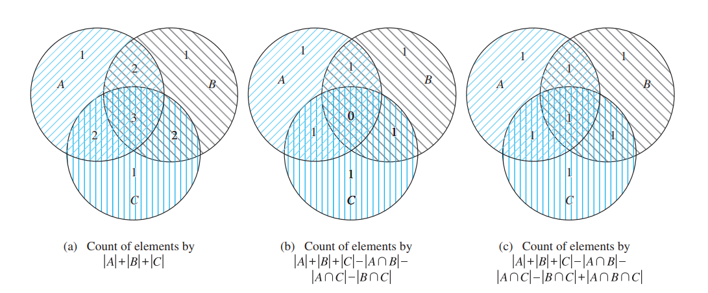
Finding a Formula for the Number of Elements in the Union of Three Sets.
To remedy this undercount, we add the number of elements in the intersection of all three sets. This final expression counts each element once, whether it is in one, two, or three of the sets.

Slide 8
Inclusion-Exclusion (3 sets)
From a total of 50 students:
|A|
30 know Java
18 know C++
26 know C#
9 know both Java and C++
16 know both Java and C#
8 know both C++ and C#
47 know at least one language.
|B|
|C|
How many know none?
How many know all?
|A Å B|
|A Å C|
|B Å C|
|A Å B Å C|
|A [ B [ C|
|A [ B [ C| = |A| + |B| + |C| – |A Å B| – |A Å C| – |B Å C| + |A Å B Å C|
47 = 30 + 18 + 26 – 9 – 16 – 8 + |A Å B Å C|
|A Å B Å C| = 6

Slide 9
Inclusion-Exclusion (4 sets)
|A [ B [ C [ D| = |A| + |B| + |C| + |D|
– |A Å B| – |A Å C| – |A Å D| – |B Å C| – |B Å D| – |C Å D|
+ |A Å B Å C| + |A Å B Å D| + |A Å C Å D| + |B Å C Å D|
– |A Å B Å C Å D |
A
B
C
D

Slide 10
Inclusion-Exclusion (n sets)
What is the inclusion-exclusion formula for the union of n sets?

Slide 11
Inclusion-Exclusion (n sets)
sum of sizes of all single sets
– sum of sizes of all 2-set intersections
+ sum of sizes of all 3-set intersections
– sum of sizes of all 4-set intersections
…
+ (–1)^{n+1} × sum of sizes of intersections of all n sets

Slide 12
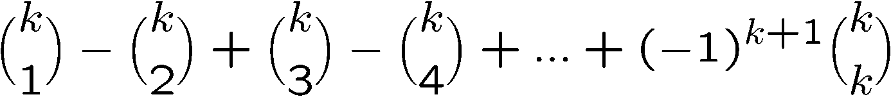

Inclusion-Exclusion (n sets)
|A₁ [ A₂ [ A₃ [ … [ A_{n}|
sum of sizes of all single sets
– sum of sizes of all 2-set intersections
+ sum of sizes of all 3-set intersections
– sum of sizes of all 4-set intersections
…
+ (–1)^{n+1} × sum of sizes of intersections of all n sets
We want to show that every element is counted exactly once.
Consider an element which belongs to exactly k sets, say A₁, A₂, A₃, …, A_{k}.
In the formula, such an element is counted the following number of times:
Therefore each element is counted exactly once, and thus the formula is correct

Slide 13
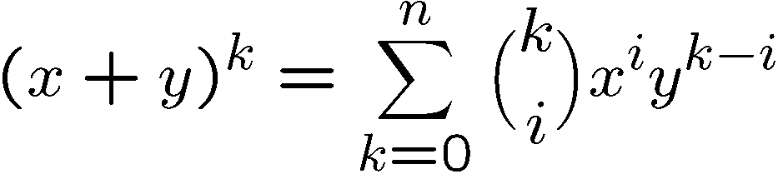

Inclusion-Exclusion (n sets)
Plug in x=1 and y=-1 in the above binomial theorem, we have

Slide 14

Christmas Party
In a Christmas party, everyone brings his/her present.
There are n people and so there are totally n presents.
Suppose the host collects and shuffles all the presents.
Now everyone picks a random present.
What is the probability that no one picks his/her own present?
Let the n presents be {1, 2, 3, …, n}, where the present i is owned by person i.
Now a random ordering of the presents means a permutation of {1, 2, 3, …, n}.
e.g. (3,2,1) means the person 1 picks present 3, person 2 picks present 2, etc.
And the question whether someone picks his/her own present becomes
whether there is a number i which is in position i of the permutation.

Slide 15
In a discrete mathematics class every student is a major in computer science or mathematics, or both. The number of students having computer science as a major (possibly along with mathematics) is 25; the number of students having mathematics as a major (possibly along with computer science) is 13; and the number of students majoring in both computer science and mathematics is 8. How many students are in this class?
Let A be the set of students in the class majoring in computer science and B be the set of students in the class majoring in mathematics. Then A ∩ B is the set of students in the class who are joint mathematics and computer science majors. Because every student in the class is majoring in either computer science or mathematics (or both), it follows that the number of students in the class is
|A ∪ B|.
Therefore,
|A ∪ B| = |A| + |B| - |A ∩ B| = 25 + 13 - 8 = 30

Slide 16
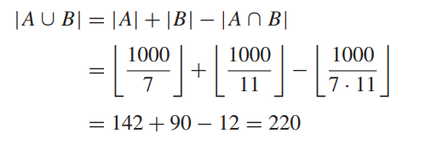
How many positive integers not exceeding 1000 are divisible by 7 or 11?
Let A be the set of positive integers not exceeding 1000 that are divisible by 7, and let B be the set of positive integers not exceeding 1000 that are divisible by 11. Then A ∪ B is the set of integers not exceeding 1000 that are divisible by either 7 or 11, and A ∩ B is the set of integers not exceeding 1000 that are divisible by both 7 and 11. We know that among the positive integers not exceeding 1000 there are 1000/7 integers divisible by 7 and 1000/11 divisible by 11. Because 7 and 11 are relatively prime, the integers divisible by both 7 and 11 are those divisible by 7 · 11. Consequently, there are 1000/(11 · 7) positive integers not exceeding 1000 that are divisible by both 7 and 11. It follows that there are

Slide 17
Suppose that there are 1807 freshmen at your school. Of these, 453 are taking a course in computer science, 567 are taking a course in mathematics, and 299 are taking courses in both computer science and mathematics. How many are not taking a course either in computer science or in mathematics?
To find the number of freshmen who are not taking a course in either mathematics or computer science, subtract the number that are taking a course in either of these subjects from the total number of freshmen. Let A be the set of all freshmen taking a course in computer science, and let B be the set of all freshmen taking a course in mathematics. It follows
that |A| = 453, |B| = 567, and |A ∩ B| = 299.
The number of freshmen taking a course in either computer science or mathematics is
|A ∪ B| = |A| + |B| − |A ∩ B| = 453 + 567 − 299 = 721.
Consequently, there are 1807 - 721 = 1086 freshmen who are not taking a course in computer science or mathematics.

Slide 18
Application of principle of inclusion and exclusion

Slide 19
Erastothenes: The goal is to list all the prime numbers between 1 and a positive integer n. The procedure is :
Remove all the multiples of 2 other than 2
Keep the first remaining integer exceeding 2, which is the prime number 3.
Remove all the multiples of 3 except 3 itself.
Keep the first remaining integer exceeding 3, prime number 5.
Remove all the multiples of 5 except 5 continue in this way:
N = 1000 1, 2, 3, . . . . , 1000

Slide 20
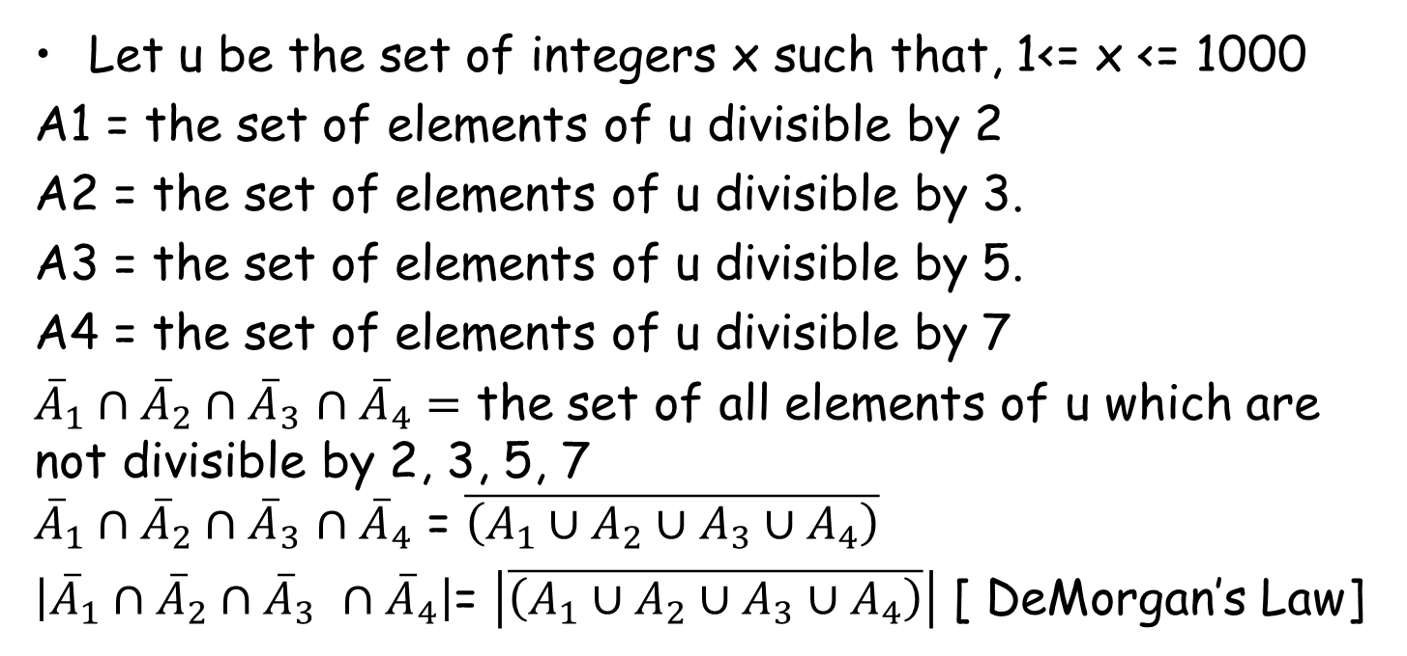
Problem: Count the number of integers between 1 and 1000 which are not divisible by 2, 3, 5, 7.
Let u be the set of integers x such that, 1<= x <= 1000
A1 = the set of elements of u divisible by 2
A2 = the set of elements of u divisible by 3.
A3 = the set of elements of u divisible by 5.
A4 = the set of elements of u divisible by 7
${\overline{A}}_{1}∩{\overline{A}}_{2}∩{\overline{A}}_{3}$ $∩{\overline{A}}_{4}=$ the set of all elements of u which are not divisible by 2, 3, 5, 7 ${\overline{A}}_{1}∩{\overline{A}}_{2}∩{\overline{A}}_{3}$ $∩{\overline{A}}_{4}$ = $\overline{\left(A_{1}∪A_{2}∪A_{3}∪A_{4}\right)}$
$\left|{\overline{A}}_{1}∩{\overline{A}}_{2}∩{\overline{A}}_{3} ∩{\overline{A}}_{4}\right|$= $\left|\overline{\left(A_{1}∪A_{2}∪A_{3}∪A_{4}\right)}\right|$ [ DeMorgan’s Law]

Slide 21
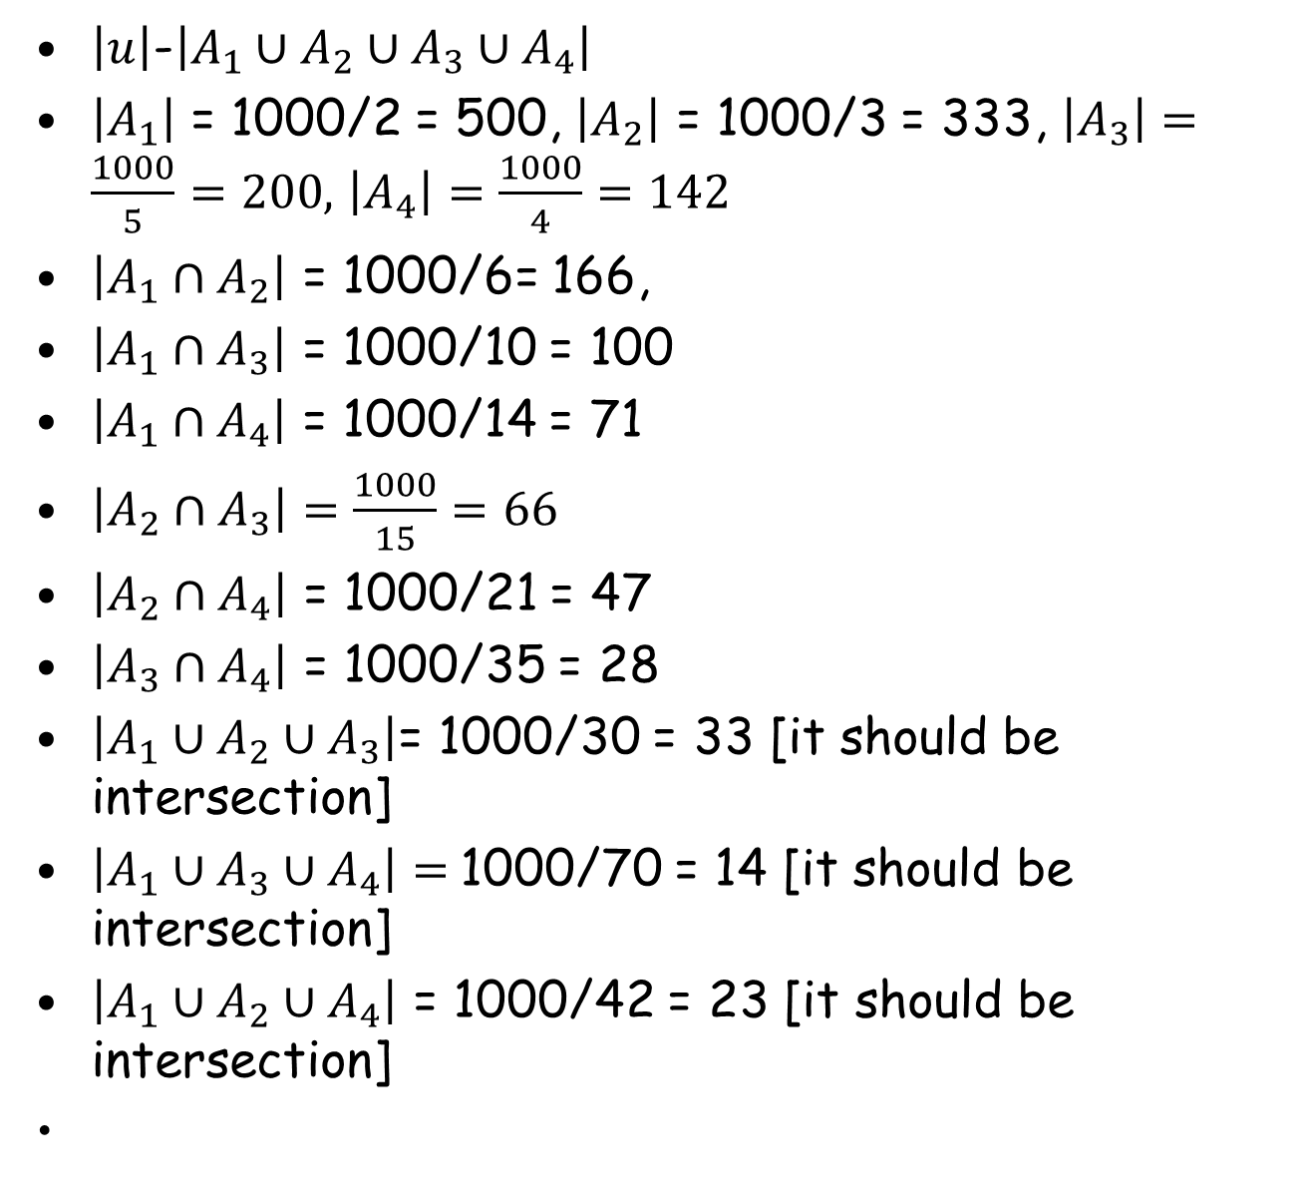
$\left|u\right|$-$\left|A_{1}∪A_{2}∪A_{3}∪A_{4}\right|$
$\left|A_{1}\right|$ = 1000/2 = 500, $\left|A_{2}\right|$ = 1000/3 = 333, $\left|A_{3}\right|=\frac{1000}{5}=200,$ $\left|A_{4}\right|=\frac{1000}{4}=142$
$\left|A_{1}∩A_{2}\right|$ = 1000/6= 166,
$\left|A_{1}∩A_{3}\right|$ = 1000/10 = 100
$\left|A_{1}∩A_{4}\right|$ = 1000/14 = 71
$\left|A_{2}∩A_{3}\right|=\frac{1000}{15}=66$
$\left|A_{2}∩A_{4}\right|$ = 1000/21 = 47
$\left|A_{3}∩A_{4}\right|$ = 1000/35 = 28
$\left|A_{1}∪A_{2}∪A_{3}\right|$= 1000/30 = 33 [it should be intersection]
$\left|A_{1}∪A_{3}∪A_{4}\right|=$1000/70 = 14 [it should be intersection]
$\left|A_{1}∪A_{2}∪A_{4}\right|$ = 1000/42 = 23 [it should be intersection]

Slide 22
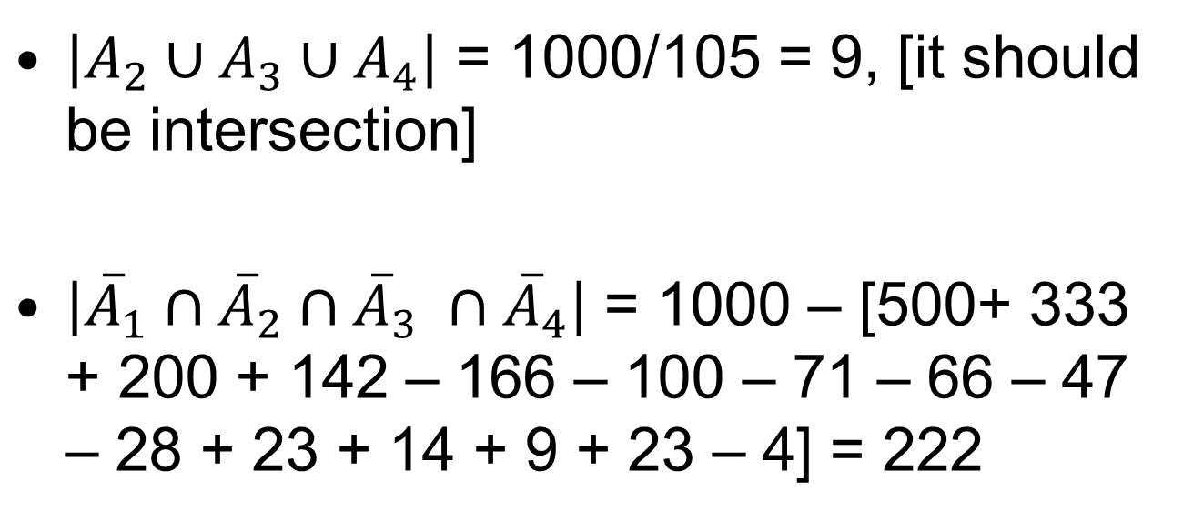
$\left|A_{2}∪A_{3}∪A_{4}\right|$ = 1000/105 = 9, [it should be intersection]
$\left|{\overline{A}}_{1}∩{\overline{A}}_{2}∩{\overline{A}}_{3} ∩{\overline{A}}_{4}\right|$ = 1000 – [500+ 333 + 200 + 142 – 166 – 100 – 71 – 66 – 47 – 28 + 23 + 14 + 9 + 23 – 4] = 222

Slide 23
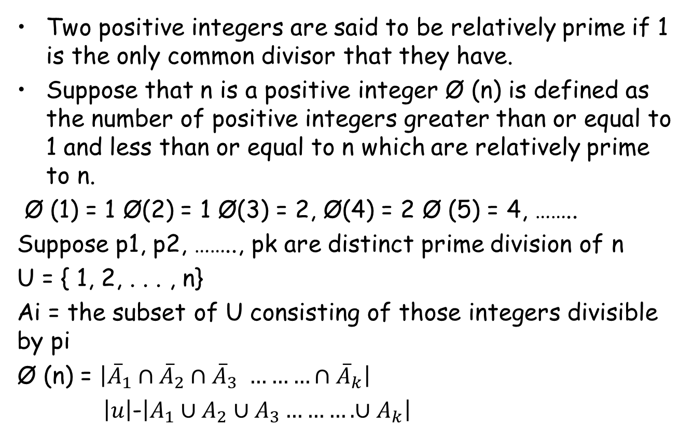
Euler’s Ø Function
Two positive integers are said to be relatively prime if 1 is the only common divisor that they have.
Suppose that n is a positive integer Ø (n) is defined as the number of positive integers greater than or equal to 1 and less than or equal to n which are relatively prime to n.
Ø (1) = 1 Ø(2) = 1 Ø(3) = 2, Ø(4) = 2 Ø (5) = 4, ……..
Suppose p1, p2, …….., pk are distinct prime division of n
U = { 1, 2, . . . , n}
Ai = the subset of U consisting of those integers divisible by pi
Ø (n) = $\left|{\overline{A}}_{1}∩{\overline{A}}_{2}∩{\overline{A}}_{3} ………∩{\overline{A}}_{k}\right|$
$\left|u\right|$-$\left|A_{1}∪A_{2}∪A_{3}……….∪A_{k}\right|$

Slide 24
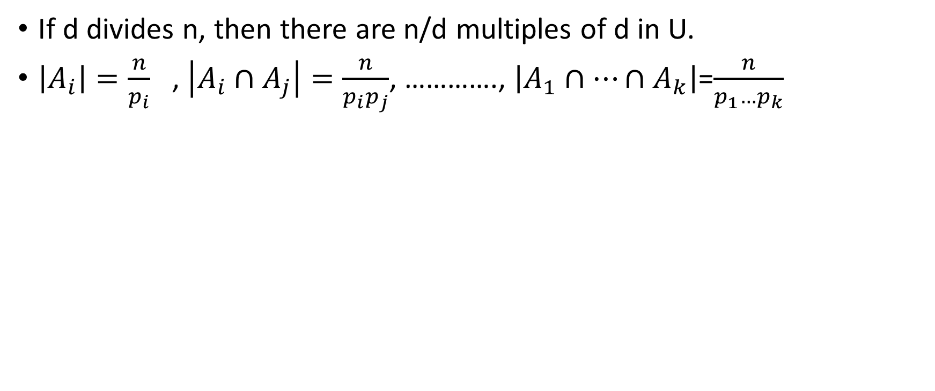
Observation
If d divides n, then there are n/d multiples of d in U.
$\left|A_{i}\right|=\frac{n}{p_{i}}$ , $\left|A_{i}∩A_{j}\right|=\frac{n}{p_{i}p_{j}}$, …………., $\left|A_{1}∩…∩A_{k}\right|$=$\frac{n}{p_{1}…p_{k}}$

Slide 25
Example (Derangements)
Among the permutations of { 1, 2, …., n} there are some permutations in which none of the n integers appears in its natural place. These permutations are called derangements.
Suppose Dn = the total number derangements on the set { 1, 2, …, n}
Ai = the set of all the permutations on { 1, 2, …., n} which keeps the ith element namely I, in its natural place.
i = 1, 2, ……, n

Slide 26
Fixed Points in a Permutation
Given a random permutation of {1, 2, 3, …, n},
what is the probability that a permutation has no fixed point
(i.e number i is not in position i for all i)?
e.g. {2, 3, 1, 5, 6, 4} has no fixed point,
{3, 4, 7, 5, 2, 6, 1} has a fixed point,
{5, 4, 3, 2, 1} has a fixed point.
You may wonder why we are suddenly asking a probability question.
Actually, this is equivalent to the following counting question:
What is the number of permutations of {1,2,3,…,n} with no fixed point?

Slide 27
Fixed Points in a Permutation
What is the number of permutations of {1,2,3,…,n} with no fixed point?
For this question, it is more convenient to count the complement.
Let S be the set of permutations of {1,2,3…,n} with some fixed point(s).
Let A₁ be the set of permutations in which the number 1 is in position 1.
…
Let A_{j} be the set of permutations in which the number j is in position j.
…
Let A_{n} be the set of permutations in which the number n is in position n.
S = A₁ [ A₂ [ … [ A_{n}
Note that A_{i} and A_{j} are not disjoint, and so we need inclusion-exclusion.

Slide 28
Fixed Points in a Permutation
Let S be the set of permutations of {1,2,3…,n} with some fixed point(s).
Let A_{j} be the set of permutations in which the number j is in position j.
S = A₁ [ A₂ [ … [ A_{n}
How large is |A_{j}|?
Once we fixed j, we can have any permutation on the remaining n-1 elements.
Therefore, |A_{j}| = (n-1)!
How large is |A_{i} Å A_{j}|?
Once we fixed i and j, we can have any permutation on the remaining n-2 elements.
Therefore, |A_{i} Å A_{j}| = (n-2)!

Slide 29
Fixed Points in a Permutation
Let S be the set of permutations of {1,2,3…,n} with some fixed point(s).
Let A_{j} be the set of permutations in which the number j is in position j.
S = A₁ [ A₂ [ … [ A_{n}
How large is the intersection of k sets?
In the intersection of k sets, there are k positions being fixed.
Then we can have any permutation on the remaining n-k elements.
Therefore, |the intersection of k sets| = (n-k)!

Slide 30




Fixed Points in a Permutation
Let S be the set of permutations of {1,2,3…,n} with some fixed point(s).
Let A_{j} be the set of permutations in which the number j is in position j.
S = A₁ [ A₂ [ … [ A_{n}
|the intersection of k sets| = (n-k)!
|S| = |A₁ [ A₂ [ … [ A_{n}|
|A₁ [ A₂ [ A₃ [ … [ A_{n}|
sum of sizes of all single sets
– sum of sizes of all 2-set intersections
+ sum of sizes of all 3-set intersections
– sum of sizes of all 4-set intersections
…
+ (–1)^{n+1} × sum of sizes of intersections of n sets
…

Slide 31
Fixed Points in a Permutation
Let S be the set of permutations of {1,2,3…,n} with some fixed point(s).
Let A_{j} be the set of permutations in which the number j is in position j.
S = A₁ [ A₂ [ … [ A_{n}
|the intersection of k sets| = (n-k)!
|S| = |A₁ [ A₂ [ … [ A_{n}|
|S| = |A₁ [ A₂ [ … [ A_{n}|
= n! – n!/2! + n!/3! +… (-1)^{i+1} n!/i! + … + (-1)^{n+1}
…

Slide 32

Fixed Points in a Permutation
Let S be the set of permutations of {1,2,3…,n} with some fixed point(s).
Let A_{j} be the set of permutations in which the number j is in position j.
S = A₁ [ A₂ [ … [ A_{n}
|S| = n! – n!/2! + n!/3! +… (-1)^{i+1} n!/i! + … + (-1)^{n+1}
The number of permutations with no fixed points
= n! – |S|
= n! – n! + n!/2! – n!/3! +… (-1)^{i} n!/i! + … + (-1)^{n}
= n! (1 – 1/1! + 1/2! – 1/3! + … + (-1)^{i} 1/i! … + (-1)^{n} 1/n!)
-> n!/e (where e is the constant 2.71828…)

Slide 33


Euler Function
Given a number n, how many numbers from 1 to n are relatively prime to n?
When n is a prime number,
then every number from 1 to n-1 is relatively prime to n,
and so
When n is a prime power,
then p, 2p, 3p, 4p, …, n are not relatively prime to n,
there are n/p = p^{c-1} of them,
and other numbers are relatively prime to n.
Therefore,

Slide 34


Euler Function
Given a number n, how many numbers from 1 to n are relatively prime to n?
Suppose
Then p, 2p, 3p, 4p, …, n are not relatively prime to n, there are n/p of them.
Also, q, 2q, 3q, 4q, …, n are not relatively prime to n, and there are n/q of them.
Other numbers are relatively prime to n.
Therefore,
The numbers pq, 2pq, 3pq, …, n are subtracted twice, and there are n/pq of them.
So the correct answer is

Slide 35

Euler Function
Given a number n, how many numbers from 1 to n are relatively prime to n?
Let
Let S be the set of numbers from 1 to n that are not relatively prime to n.
Let A_{i} be the set of numbers that are a multiple of p_{i}.
S = A₁ [ A₂ [ … [ A_{n}
For the intersection of k sets, say A₁, A₂, A₃,…, A_{k}
then every number in A₁ Å A₂ Å … Å A_{k} is a multiple of p₁p₂…p_{k}
then |A₁ Å A₂ Å … Å A_{k}| = n/p₁p₂…p_{k}

Slide 36
Euler Function
Given a number n, how many numbers from 1 to n are relatively prime to n?
Let
Let S be the set of numbers from 1 to n that are not relatively prime to n.
Let A_{i} be the set of numbers that are a multiple of p_{i}.
S = A₁ [ A₂ [ … [ A_{n}
|A₁ Å A₂ Å … Å A_{k}| = n/p₁p₂…p_{k}
|A₁ [ A₂ [ A₃| = |A₁| + |A₂| + |A₃|
– |A₁ Å A₂| – |A₁ Å A₃| – |A₂ Å A₃|
+ |A₁ Å A₂ Å A₃|
When r=3 (only 3 distinct factors),
|A₁ [ A₂ [ A₃|
= n/p₁ + n/p₂ + n/p₃
- n/p₁p₂ – n/p₁p₃ – n/p₂p₃ + n/p₁p₂p₃
= n(1-p₁)(1-p₂)(1-p₃)

Slide 37
Euler Function
Given a number n, how many numbers from 1 to n are relatively prime to n?
Let
Let S be the set of numbers from 1 to n that are not relatively prime to n.
Let A_{i} be the set of numbers that are a multiple of p_{i}.
S = A₁ [ A₂ [ … [ A_{n}
|A₁ Å A₂ Å … Å A_{k}| = n/p₁p₂…p_{k}
|A₁ [ A₂ [ A₃ [ … [ A_{n}|
|S| = |A₁ [ A₂ [ … [ A_{n}|
sum of sizes of all single sets
– sum of sizes of all 2-set intersections
+ sum of sizes of all 3-set intersections
– sum of sizes of all 4-set intersections
…
+ (–1)^{n+1} × sum of sizes of intersections of n sets
calculations…
= n(1-p₁)(1-p₂)…(1-p_{n})

Slide 38
Quick Summary
We have studied how to determine the size of a set directly.
The basic rules are the sum rule, product rule, and the generalized product rule.
We apply these rules in counting permutations and combinations,
which are then used to count other objects like poker hands.
Then we prove the binomial theorem and study combinatorial proofs of identities.
Finally we learn the inclusion-exclusion principle and see some applications.
Later we will learn how to count “indirectly” by “mapping”.

